Slide 1
Amsterdam in Motion
Wim Rick Thom Daan Ruben
Notes:
change title to our own idea

Slide 2
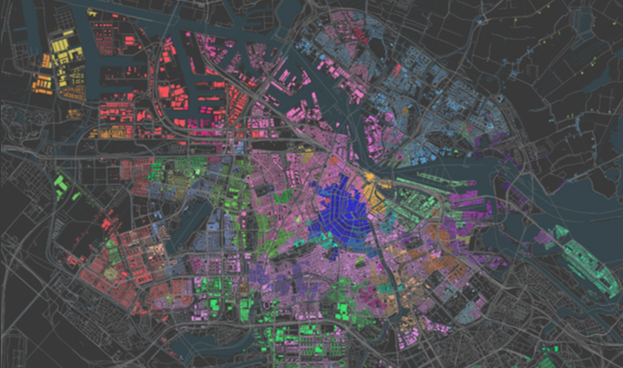
Challenge
Nowadays everything is tracked on various social media platforms.
Easy to track individuals, lack of information on sport activity trends.
Gather and analyze sport activity information in certain areas.

Slide 3
Get insight in where a sport activity is more popular and most importantly on which time and day of the week.

Slide 4
Idea
Gather information on when and where people are working out.
Define neighbourhoods based on type of exercise, age and gender.
Display trends of exercises based on time of day and day of the week.
Notes:
Note on age, maybe not possible, try to get it working with Face++ (both Twitter and Strava hides these attributes)

Slide 5
Our approach
Source: Twitter, Strava
Message ranking function: BM25
Categories: a list of sport activities
Per category: taxonomy
Running taxonomy: Hardlopen, sprinten, lopen,
User interface: Mapbox
Notes:
Waarom BM25? Omdat gebruik maakt van IDF. Waarom is dat handig nou hierom:
In other words, TF*IDF measures the relative concentration of a term in a given piece of text. If “dog” is common in this article, but relatively rare elsewhere, then the TF*IDF score will be high. This article ought to be thought of as very relevant to the search term “dog.” If “dog” occurs once here, but very prominently in many other docs, its score will be relatively low.

Slide 6
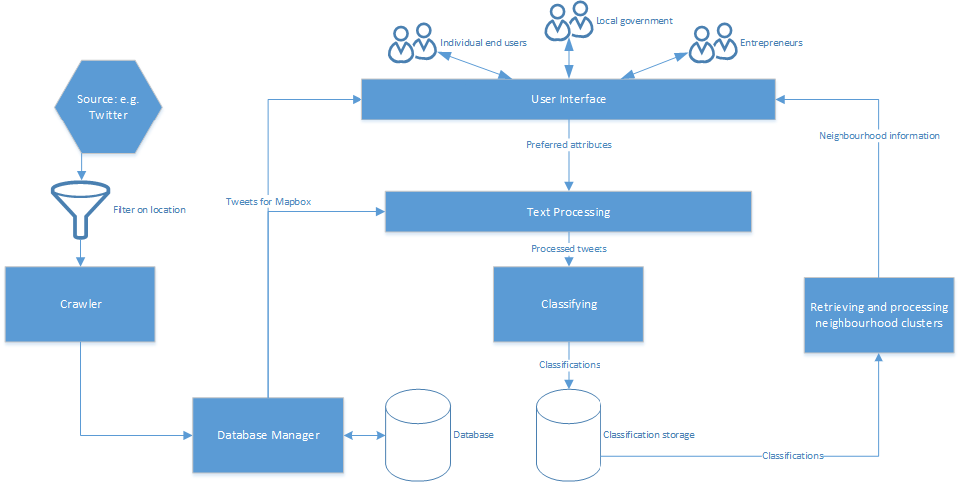
Pipeline
Notes:
Geo-filtered Twitter data is gathered
Data is clustered based on attributes
The clusters are presented in Mapbox

Slide 7
Timeline
3.4 3.5 3.6 3.7 3.8 3.9
Idea Document Data collection Text processing User Interface Finishing product Presentation
& Management & Classification
Everyone Twitter: Wim & Ruben Daan & Thom Everyone Everyone
Rick & Wim & Thom
Strava: Daan & Ruben

